Slide 1



DBA5102 Group Project
Predicting Bitcoin
Prices
. .
Ankit Malhotra - A0232322X
Donghwan Kim - A0231887U
Felipe Chapa - A0179033E
Sahil Sharma - A0232063U
Widya Gani Salim - A0231857Y
Wong Cheng An - A0232039M
Scan/click to find a surprise Bitcoin visualiser!
(Different for each slide)

Slide 2

Table of Contents
Problem Statement
Data Gathering & Processing
Data Sources
Exploratory Data Analysis
Feature Engineering
Prediction Strategy
Prediction Horizon & Frequency
Model Selection
Prediction Model
Time Series Modelling
LSTM
Final Model
Conclusion
Future Improvements
DBA5102 Group Project: Predicting Bitcoin Prices

Slide 3
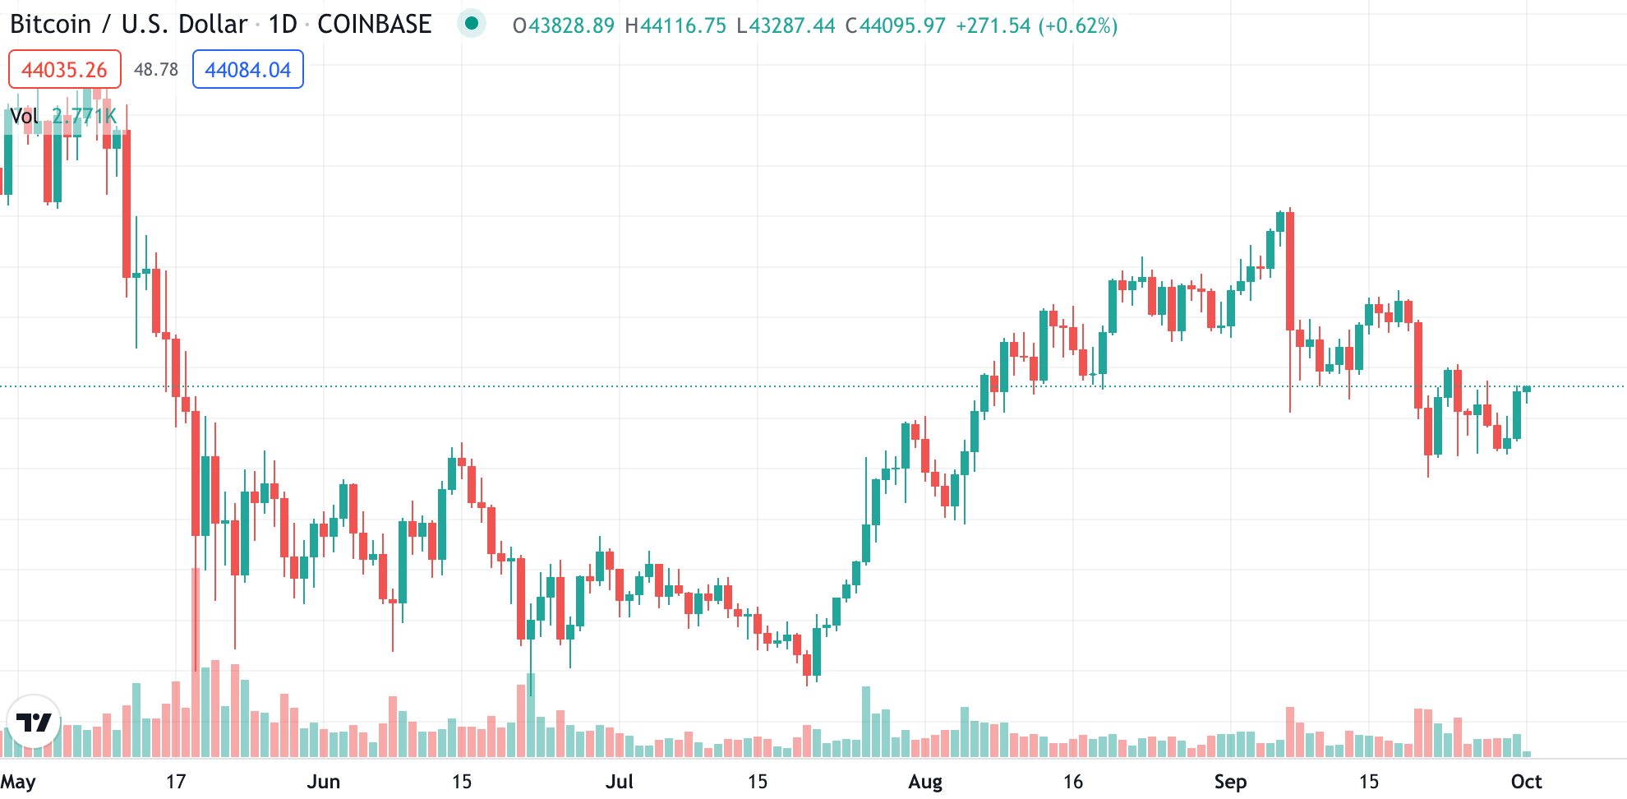

Problem Statement
Objective: Find the best data sources and models to predict Bitcoin (BTC) prices.
Why is BTC price so volatile?
Lack of regulations
Supply limitation/scarcity
Correlation with other assets/stock market
Lack of investment infrastructure
DBA5102 Group Project: Predicting Bitcoin Prices
Notes:
Over the past few years, Bitcoin (BTC) has been rising as a novel form of technology and alternative investment. Noted for its price volatility and spreading popularity, many traders have hoped to predict the Bitcoin future prices. With the recent halving and cryptocurrency price bubble, this is a great time to test our knowledge???

Slide 4
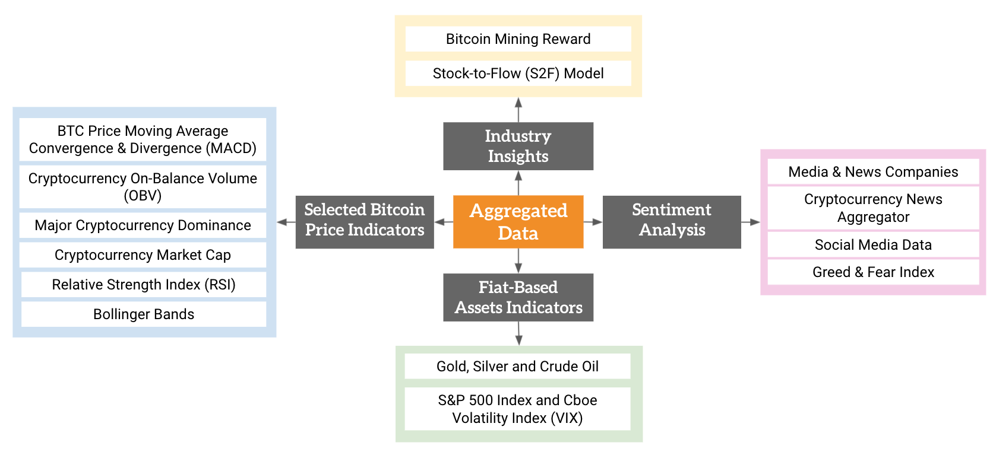








Data Gathering & Processing
We focused on gathering data which could be categorised into 4 groups:
Industry Insights
Indicators accounting for Bitcoin’s scarcity and mining reward.
Selected Bitcoin Price Indicators
Include common cryptocurrency trading indicators such as RSI, MACD, OBV, market dominance and cap.
Sentiment Analysis
Indicators that capture the public’s and industry sentiment.
Fiat-Based Assets Indicators
Selected other asset/market prices that could be correlated with BTC price.
Collected 1,646,826 data points & 123,791 entries from 20 data sources.
DBA5102 Group Project: Predicting Bitcoin Prices
Notes:
Widya: Could you focus on just talking about the categories (maybe category +1 example) and emphasize a bit more on the NLP. (explain we used twitter, news, sentiment analysis with 2 NLP libraries)

Slide 5
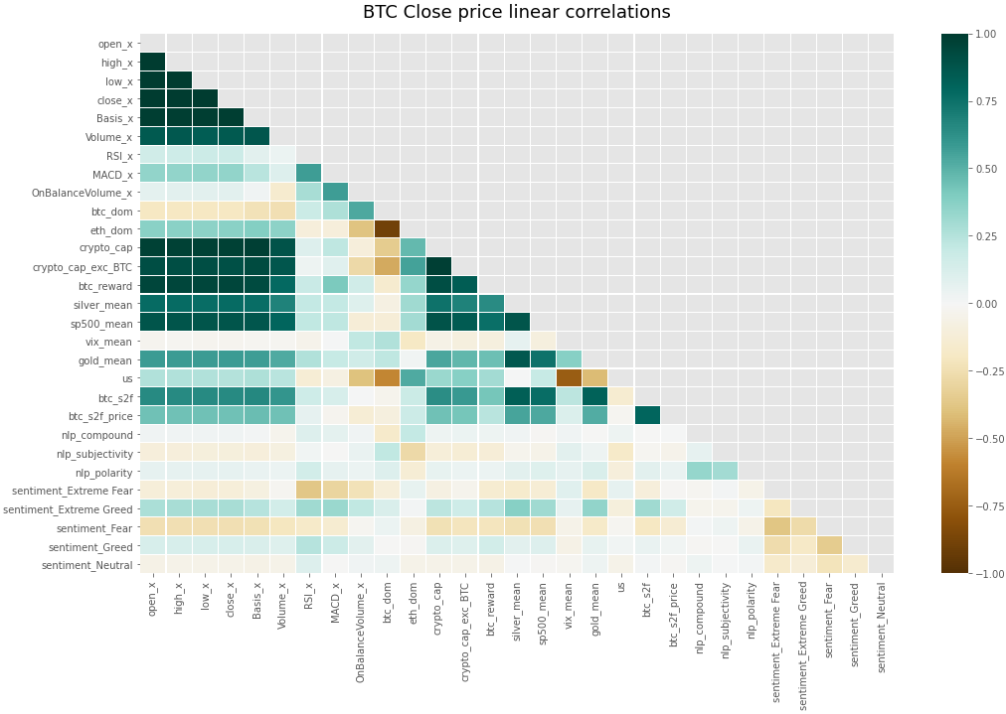
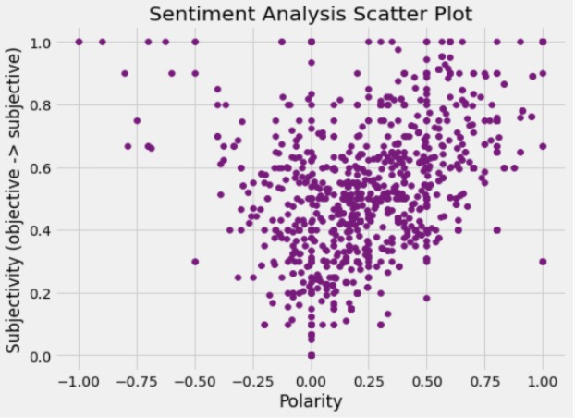
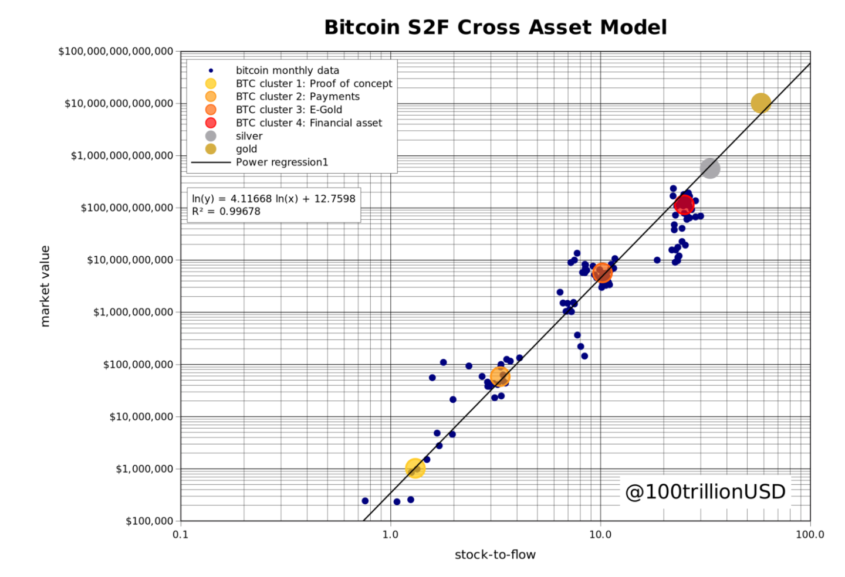

Data Gathering & Processing
Asset 1 - Correlation Heatmap between all features and BTC prices
Asset 2 - Social Media Data Sentiment Analysis Polarity
Asset 3 - Bitcoin S2F Cross Asset Model Graph^{[1]}
Feature Engineering:
- Aggregated articles & indicators from top exchanges and cryptocurrency news aggregators
- Sentiment analysis through Natural Language Processing (NLP) on Tweets and news articles (Web crawling + Twitter API)
- Predicted BTC Stock-to-Flow (S2F)^{[1]} index and estimated price using BTC mining data
- Turned Greed & Fear Sentiment Index into dummy variables
DBA5102 Group Project: Predicting Bitcoin Prices

Slide 6
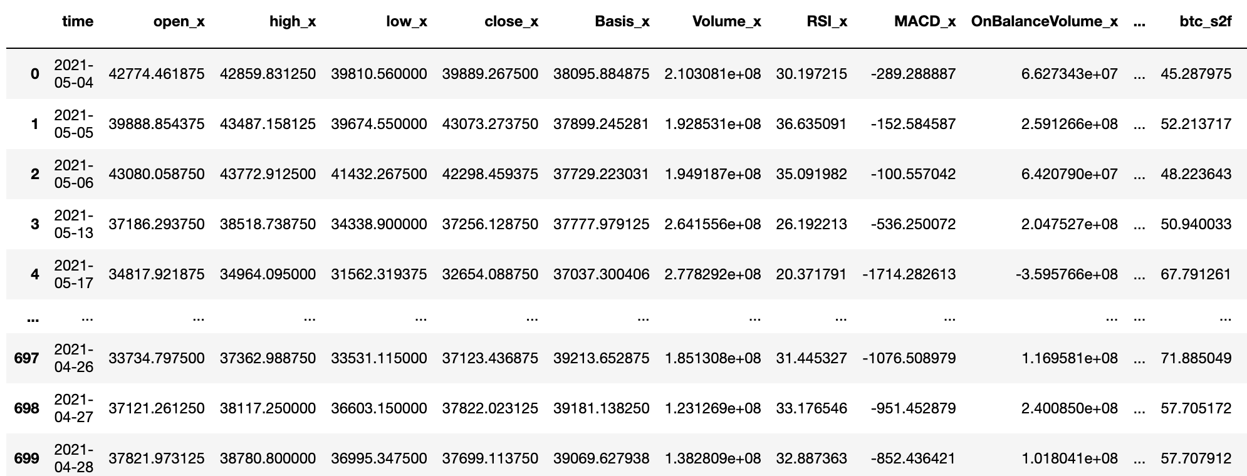
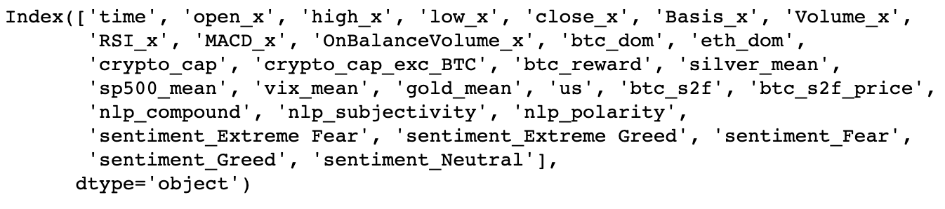

Data Gathering & Processing
Selected columns:
From 1.6 million data points & 123,791 rows from 20 data sources collected
Clean aggregated data has 41,403 data points, 1,488 entries & 30 selected features.
DBA5102 Group Project: Predicting Bitcoin Prices

Slide 7
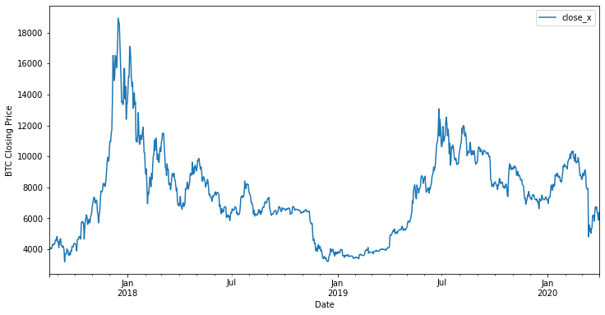
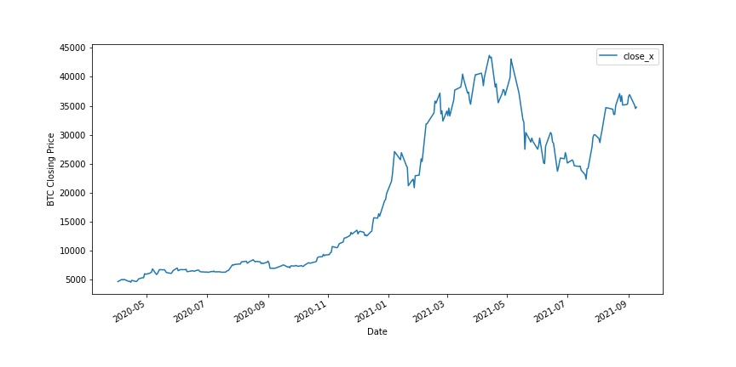

Prediction Strategy
Prediction Horizon: January 2018 - September 2021
Cryptocurrency Winter: 2018 Crash
Cryptocurrency Boom and Crash: 2020 Halving
BTC Price From January 2018 - May 2020
BTC Price from May 2020 - September 2021
DBA5102 Group Project: Predicting Bitcoin Prices

Slide 8
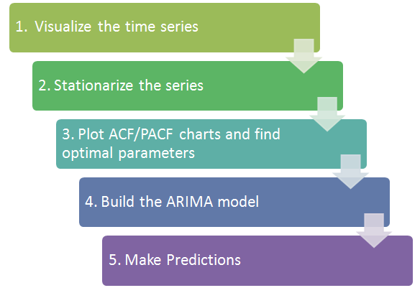
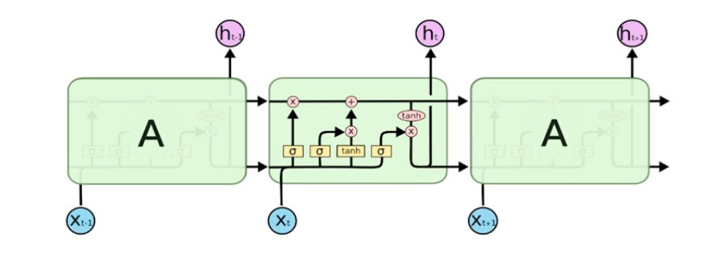

Prediction Strategy
Prediction Frequency: Monthly (1M) for SARIMA & Daily (1D) for LSTM
Model Selection
Seasonal Autoregressive Integrated Moving Average (SARIMA)
Long-Short Term Memory (LSTM)
Asset 5 - Internal Structure of LSTM^{[2]}
Asset 4 - SARIMA Thought Process
Suitable for time series prediction, commonly used to predict stock prices^{[3]}.
Able to resolve the problem of long-term dependence with internal gate mechanisms^{[2]}.
Traditional basic methodology for financial time series.
Requires the linear variation in the stock prices to remain stationary^{[4]}.
DBA5102 Group Project: Predicting Bitcoin Prices
Notes:
The ability of memorizing sequence of data makes the LSTM a special kind of RNNs. Every LSTM node most be consisting of a set of cells responsible of storing passed data streams, the upper line in each cell links the models as transport line handing over data from the past to the present ones, the independency of cells helps the model dispose filter of add values of a cell to another.

Slide 9
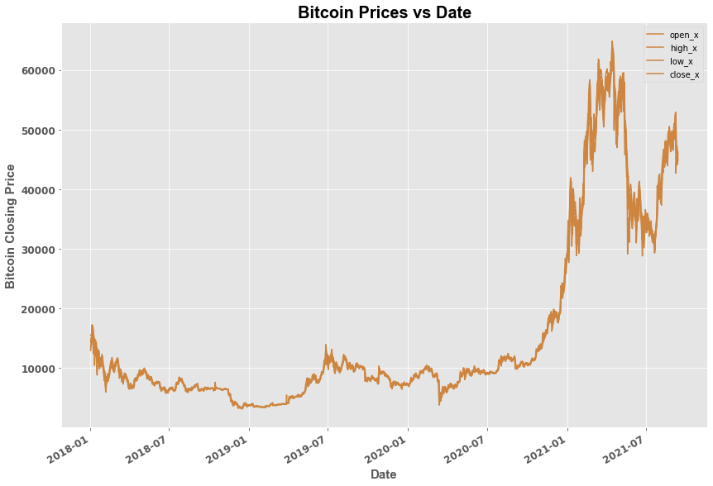
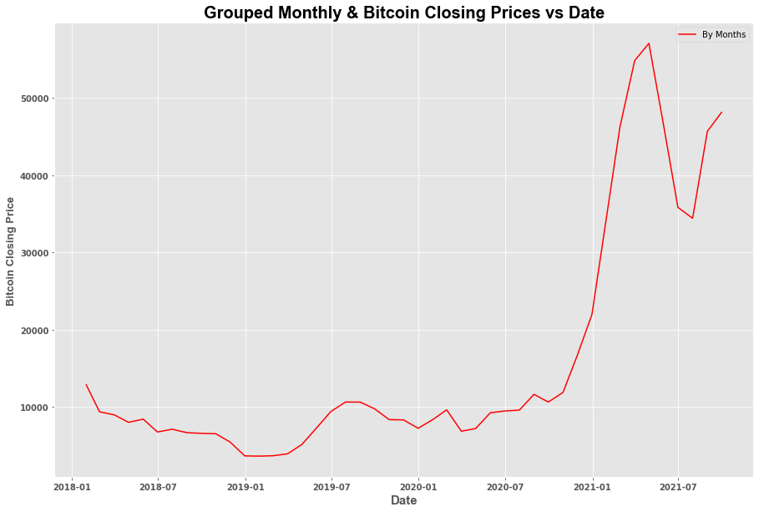
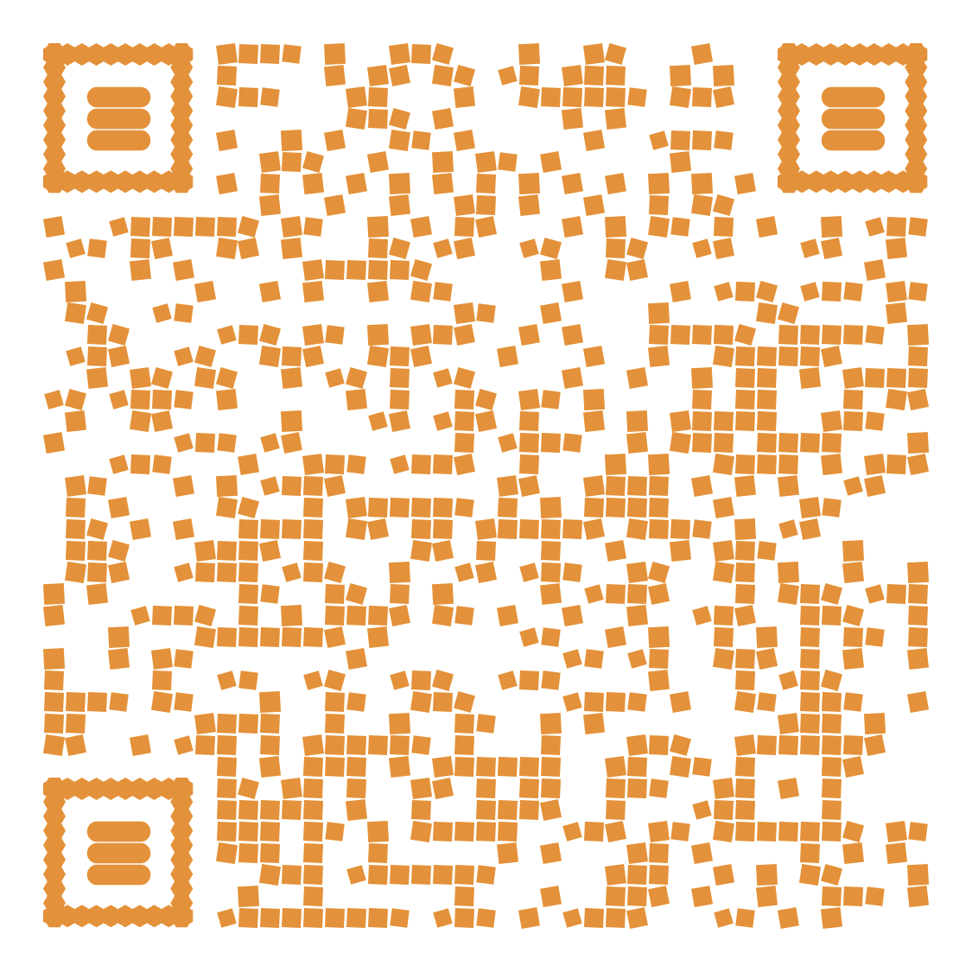
Time Series Modelling
Feature Used | Time Frame | Data Used | Validation Horizon
Bitcoin Closing Price | Monthly | Past 4 years | 5 months (Apr ’21- Sep ’21)
DBA5102 Group Project: Predicting Bitcoin Prices

Slide 10
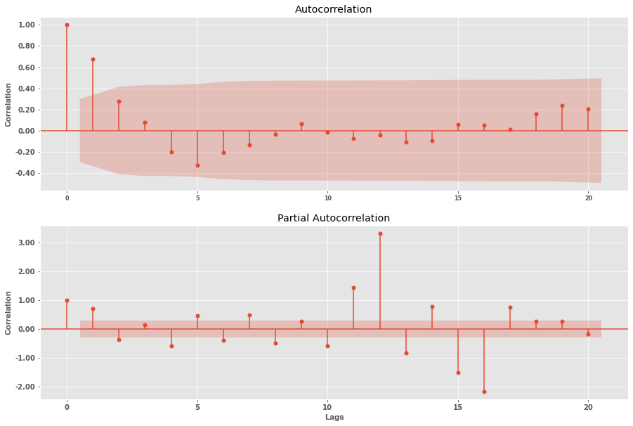
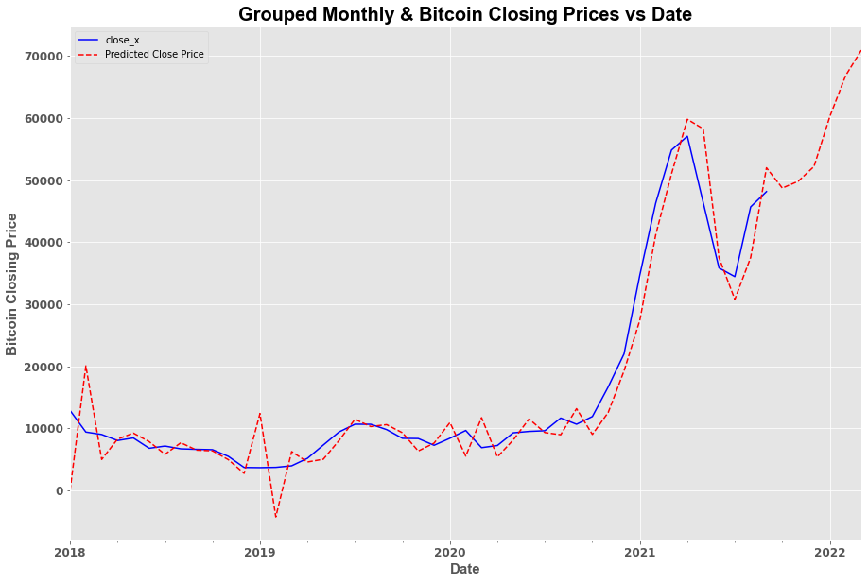

Time Series Modelling
Plotting ACF and PACF plots
Prediction Result (SARIMA)
Mean Absolute Percentage Error (MAPE): 31%
Root Mean Squared Error (RMSE): 4,478.52
DBA5102 Group Project: Predicting Bitcoin Prices

Slide 11

Long-Short Term Memory (LSTM) Model
Features Selection | Train RMSE | Val. RMSE | Val. MAPE
Sentiment Analysis (TextBlob library), Bitcoin Price Indicators | 676 | 3,627 | 7.3%
Bitcoin Price Indicators | 791 | 3,698 | 7.2%
Bitcoin Price Indicators, Industry Insights, Fiat-Based Asset Indicators BTC Trade, Sentiment Analysis | 710 | 4,448 | 9%
... | ... | ... | ...
Parameter tuning
Feature selection
Final model tuning
Forecast
DBA5102 Group Project: Predicting Bitcoin Prices
Notes:
insights found during our initial data exploration, correlation indicators and business understanding,
as well as comparing optimized model performance for different feature sets.

Slide 12
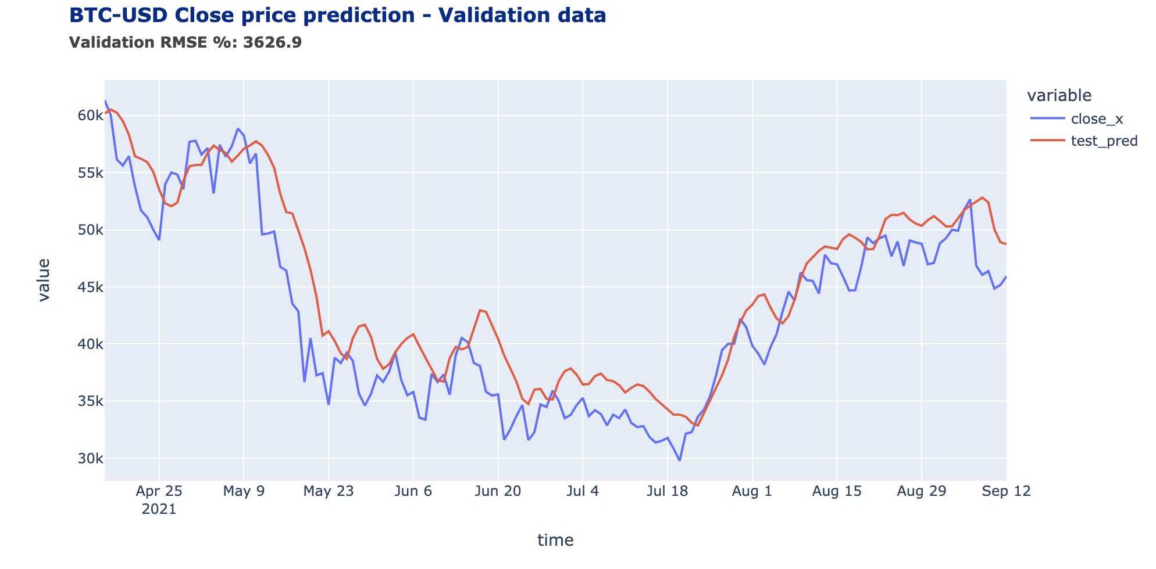
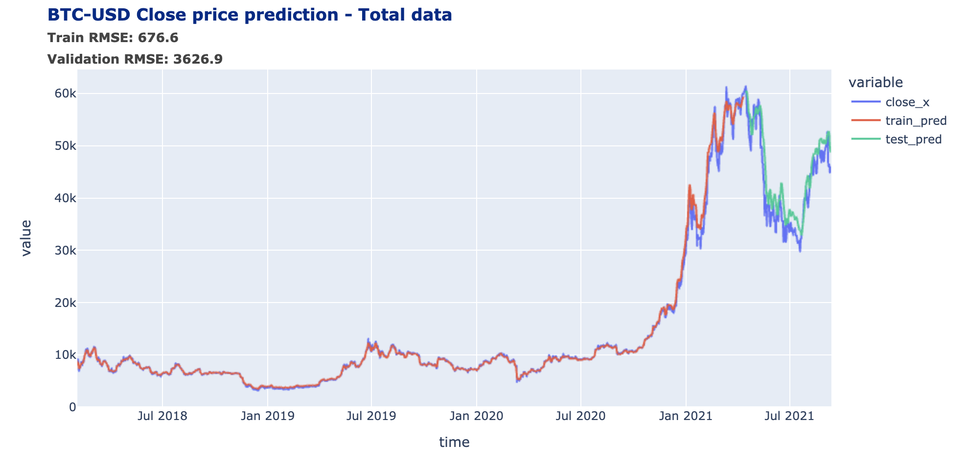

Final Model
Long-Short Term Model (LSTM): 1-Day step forecasting trained on 6 features
Feature Used | Time Frame | Hidden Layers | Dropout | Epochs | Data Used | Timestep | Validation Horizon
BTC Trade indicators, Sentiment Analysis | Daily | 4 | ~20% | 50 | Past 4 years | 3 days | 5 months (Apr ’21- Sep ’21)
DBA5102 Group Project: Predicting Bitcoin Prices
Notes:
Add epochs, units, dropouts

Slide 13





Conclusion
LSTM model:
MAPE: 7%
RMSE: 3627
Prediction frequency
Daily step forecast
Feature selection
30 indicators
Financial & NLP
Time horizon
Feb 2018 - Sep 2021
Including a boom/crash cycle
Potential improvements:
Longer time horizon to include more BTC halving and cryptocurrency boom & crash cycles
Reevaluate feature engineering and selection to get more value from existing data
Higher tuning of chosen model
Include S2F of other assets - such as Gold or Silver - as a comparison
For sentiment analysis, assign weightage on selected influencers and number of Tweets (e.g. based on tweet likes/comments)
DBA5102 Group Project: Predicting Bitcoin Prices
Notes:
Include infographics for top part

Slide 14
Thank You
DBA5102 Group Project: Predicting Bitcoin Prices

Slide 15
Appendix
DBA5102 Group Project: Predicting Bitcoin Prices

Slide 16
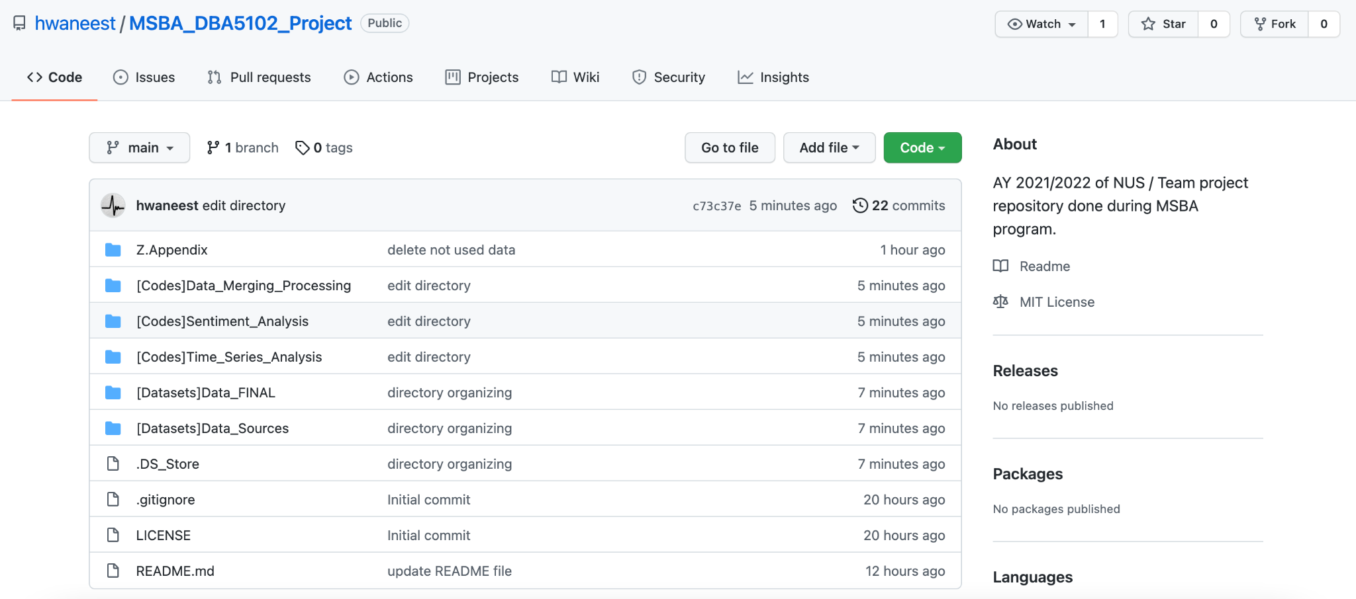
Code & Data Repository
All datasets and codes can be found on our Github Repository:
https://github.com/hwaneest/MSBA_DBA5102_Project
DBA5102 Group Project: Predicting Bitcoin Prices

Slide 17
Data Sources Breakdown
Data Source | Details | Category/Used in
Coinmetrics.io | BTC Mining Reward (used to create S2F index) | Industry Insights
Blockchair | BTC Mining Reward (benchmark) | Industry Insights
Trading View | BTC and ETH Market Dominance | BTC Price Indicators
Coinmarketcap | Cryptocurrency Market Cap | BTC Price Indicators
Top 5 Cryptocurrency Exchanges (by Volume) | Scraped trading prices and indicators data from Coinbase, Binance, FTX, Huobi, KuCoin | BTC price indicators
NASDAQ | S&P 500 Data | Fiat-Based Assets Indicators
Currency.com | Gold Price Index, Silver Price Index | Fiat-Based Assets Indicators
TVC | VIC Index, Crude Oil Prices | Fiat-Based Assets Indicators
DBA5102 Group Project: Predicting Bitcoin Prices

Slide 18
Data Sources Breakdown
Data Source | Details | Category/Used in
Twitter | Bitcoin influencers selected: Tone Vays, John Mcafee, Vitalik Buterin, Andreas M. Antonopoulos, Tim Draper, Roger Ver, Elon Musk, Cathie Wood, Jack Dorsey, Michael J. Saylor, CobraBitcoin, Erik Voorhees, Ben Armstrong, Vinny Lingham, Adam Back, Gavin Andresen, Nick Szabo News station selected: Bloomberg Technology, Bloomberg Crypto, Bloomberg, MarketWatch, The Wall Street Journal, The Economist, CNBC's Fast Money, CNBC, CNN Money, CNN business, CNN Breaking News, Financial Times, Forbes Crypto, Barron's, Yahoo Finance, Traders Magazine, MetaStock, Benzinga Crypto | Sentiment Analysis
Top 5 Cryptocurrency News Aggregator | CCN, NewsBTC, Cointelegraph, Coindesk, Forklog | Sentiment Analysis
Alternative.me | Greed & Fear Index | Sentiment Analysis
Kaggle | Raw data of BTC news aggregator | Sentiment Analysis
DBA5102 Group Project: Predicting Bitcoin Prices

Slide 19
Brief Explanation on Selected Features
Indicators | Details
Relative Strength Index (RSI) | Momentum indicator to measure the magnitude of recent price changes, measuring whether an asset is oversold or overbought.
Moving Average Convergence & Divergence (MACD) | Indicator measuring the relationship between two moving averages of an asset’s price, 26-period Moving Averages and 12-period Moving Averages.
Bollinger Bands | Statistical chart measuring possible upper and lower bound of asset prices.
Market Dominance (BTC/ETH) | Market cap dominance of a cryptocurrency.
On Balance Volume (OBV) | Momentum indicator that measures volume flow or changes to predict prices.
Cryptocurrency Greed & Fear Index | Market indicator that takes into account volatility, dominance, media sentiments, trends and volume.
DBA5102 Group Project: Predicting Bitcoin Prices

Slide 20
Brief Explanation on Selected Features
Indicators | Details
Bitcoin S2F Index | Index that divides stock (the size of existing stockpiles) with flow (year production), used to measure Bitcoin scarcity.
Bitcoin S2F Index Predicted Price | Predicted price based on the Bitcoin S2F Index model (refer to “Asset & Study References” slide for more details).
Bitcoin Mining Reward | Bitcoin block reward against price at each period.
NLP Polarity | Classifies negative and positive sentiments. Values range between (-1,1)
NLP Compound | Classify the text if it is extremely negative or positive. Values range between (-1,1)
NLP Subjectivity | Distinguishes between facts and people opinions. Values range between (0,1)
DBA5102 Group Project: Predicting Bitcoin Prices

Slide 21
Asset & Study References
[1] - Bitcoin Stock-to-Flow Cross Asset Model by Plan B
https://medium.com/@100trillionUSD/bitcoin-stock-to-flow-cross-asset-model-50d260feed12
[2] - Stock Market Prediction Using LSTM Recurrent Neural Network by Adil Moghara & Mohamed Hamiche
https://www.sciencedirect.com/science/article/pii/S1877050920304865
[3] - MRC-LSTM: A Hybrid Approach of Multi-scale Residual CNN and LSTM to Predict Bitcoin Price by
Qiutong Guo, Shun Lei, Qing Ye and Zhiyang Fang
https://arxiv.org/pdf/2105.00707.pdf
[4] - The Interval Slope Method for Long-Term Forecasting of Stock Price Trends by Chun-xue Nie & Xue-bo Jin
https://www.hindawi.com/journals/amp/2016/8045656/
[5] - Time Series Analysis in Python: An Introduction
https://towardsdatascience.com/time-series-analysis-in-python-an-introduction-70d5a5b1d52a
DBA5102 Group Project: Predicting Bitcoin Prices

Slide 22
Key Libraries Leveraged
Web crawling & data mining
Beautiful Soup
NLTK
Textblob
Alternative.me API
Blockchair API
Coinmetrics API
Twitter API
LSTM - Neural Network
Keras
Tensorflow
SARIMA - Time Series
Statsmodels
Visualisation
matplotlib
Plotly
Seaborn
Others
Multiprocessing
Numpy
Pandas
Pickle
Sklearn
DBA5102 Group Project: Predicting Bitcoin Prices

Slide 23
Thank You
DBA5102 Group Project: Predicting Bitcoin Prices

Slide 24
Table of Contents
Evaluation criteria
! Richness of data sources – time series data, social media data, public news, etc.
! Technical soundness: time series methods, machine learning methods, etc. ! Prediction strategy: prediction horizon, prediction frequency, ! Creativity in delivery format ! Quality of the presentation ! Prediction accuracy: RMSE
DBA5102 Group Project: Predicting Bitcoin Prices

Slide 25
Bitcoin Mining Reward
Stock-to-Flow (S2F) Model
BTC Price Moving Average Convergence & Divergence (MACD)
Industry
Insights
Cryptocurrency On-Balance Volume (OBV)
Media & News Companies
Selected Bitcoin Price Indicators
Aggregated Data
Sentiment Analysis
Cryptocurrency News Aggregator
Major Cryptocurrency Dominance
Cryptocurrency Market Cap
Social Media Data
Greed & Fear Index
Relative Strength Index (RSI)
Fiat-Based
Assets Indicators
Bollinger Bands
Gold, Silver and Crude Oil
S&P 500 Index and Cboe Volatility Index (VIX)

Slide 26

Bitcoin Visualizations
Bitnodes
Network Map
Daily Blockchain
Txstreet
Coindesk Data
Maps of
Coins
Satoshi Place
Interaqt
Wizbit
Blockchain Tweets
Coin360
BitListen
Mempool
Bitbonkers
DBA5102 Group Project: Predicting Bitcoin Prices

